Slide 1



Lecture – 14 Introduction to different Text editors By : Naveen Tiwari
LINUX ADMINISTRATION
1

Slide 2


Gedit editor
text editor for the GNOME Desktop
GNOME -GNU Network Object Model Environment
To Open gedit
cmd :$gedit
To save file – ctrl+s
To copy from file – ctrl+c
To open a file - $gedit filename

Slide 3
Vi (visual editor) editor
It is default editor that comes with the UNIX OS.
Using vi editor, we can edit an existing file or create a new file from scratch and read a file.
Syntax : $vi filename
Eg :
Modes of Operation in vi editor
There are three modes of operation in vi:
Command mode
Insert mode
Last Line Mode(Escape Mode)

Slide 4
1. Command Mode
When vi starts up, it is in Command Mode.
This mode is where vi interprets any characters we type as commands and thus does not display them in the window.
This mode allows us to move through a file, and to delete, copy, or paste a piece of text.
To enter into Command Mode from any other mode, it requires pressing the [Esc] key.
If we press [Esc] when we are already in Command Mode, then vi will beep or flash the screen.

Slide 5
2. Insert mode
This mode enables you to insert text into the file.
Everything that’s typed in this mode is interpreted as input and finally, it is put in the file.
To enter text, you must be in insert mode.
To come in insert mode you simply type i.
To get out of insert mode, press the Esc key, which will put you back into command mode.

Slide 6
3. Last Line Mode(Escape Mode)
Line Mode is invoked by typing a colon [:], while vi is in Command Mode.
The cursor will jump to the last line of the screen and vi will wait for a command.
This mode enables you to perform tasks such as saving files, executing commands.

Slide 7
Starting the vi Editor
Creates a new file if it already not exist, otherwise opens existing file.
cmd : $vi filename
Eg :
Opens an existing file in read only mode.
cmd : $vi -R filename
Eg :
Opens an existing file in read only mode
cmd : $view filename
Eg :

Slide 8
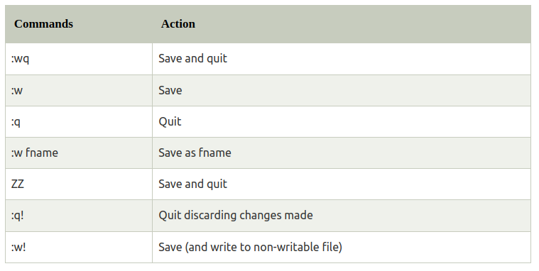
To save and quit in vi

Slide 9
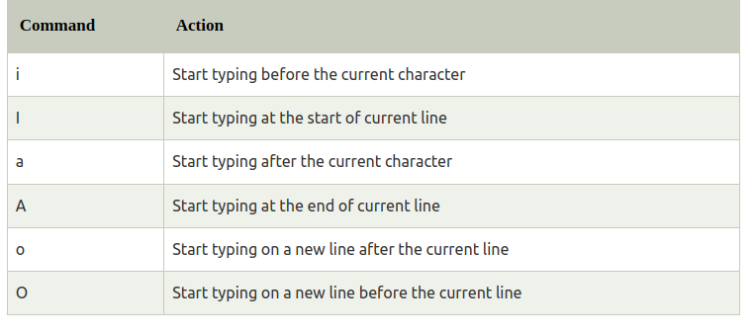
To switch from command to insert mode in vi

Slide 10
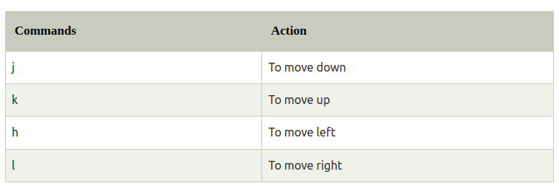
To move around a file in vi

Slide 11
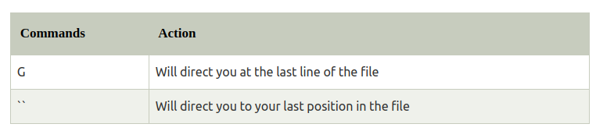
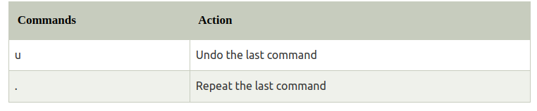
To jump lines in vi
To repeat and undo vi

Slide 12
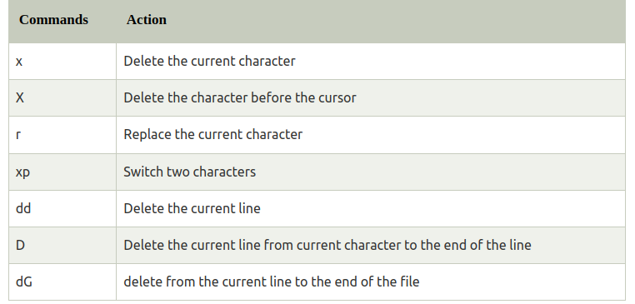
To delete in vi

Slide 13
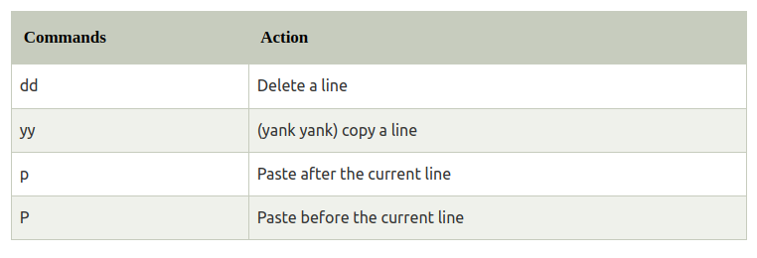
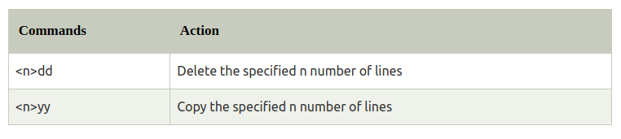
Command to cut, copy and paste in vi
Command to cut, copy and paste in vi

Slide 14
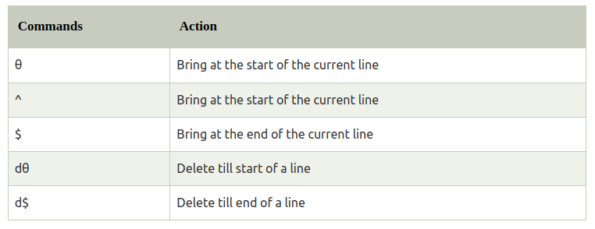
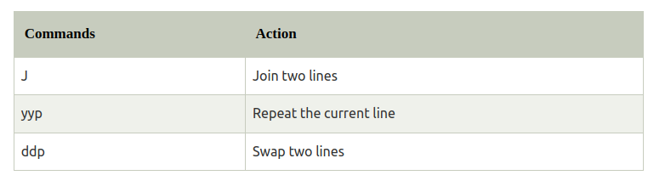
Start and end of line in vi
Joining lines in vi

Slide 15
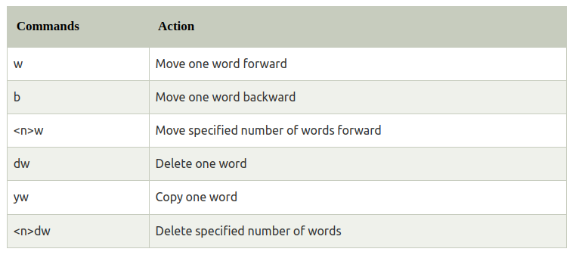
Move forward or backward in vi

Slide 16
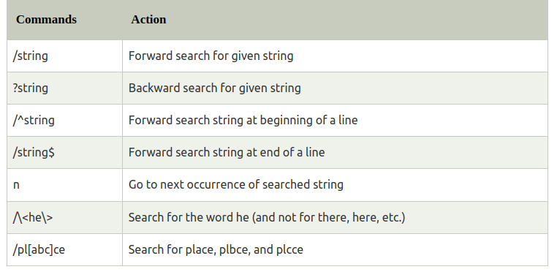
Search a string in vi

Slide 17
vim
Vim is an advanced and highly configurable text editor built to enable efficient text editing.
Developed by Bram Moolenaar.
It supports most file types and vim editor is also known as a programmer’s editor.
We can use its plugin based on our needs
Syntax : $vim [Options] [filenames]
Eg :
To open vim
cmd : $vim
cmd : $vim filename
Eg :

Slide 18
To write into file in vim – Press i
To save and Exit – Press Esc key then :wq!
To exit without saving the file - :q!
To To quit and save changes - Press the Esc key then :wq
To see vim tutorial - vimtutor
To close vim - ZZ

